Slide 1
Daniel Shaw Laura Brass
University Canada West Vancouver Community College

Slide 2
www.tricider.com
WHAT IT IS
HOW IT WORKS
WHY IT IS A GREAT LEARNING TOOL
EXAMPLES
DEMO QUESTION
REWARD ☺

Slide 3
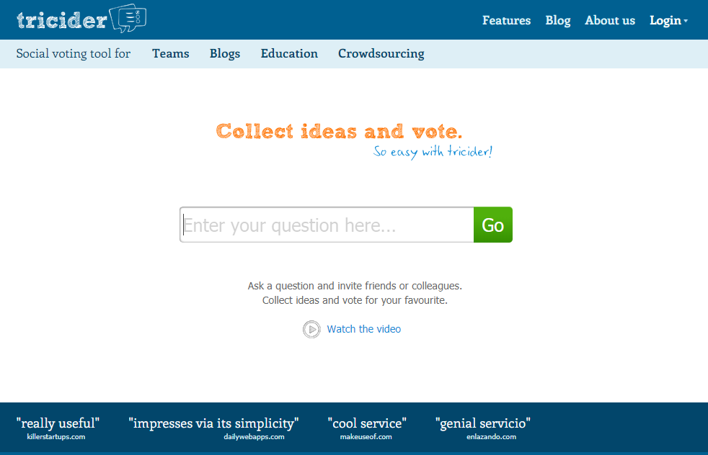
www.tricider.com
WHAT IT IS
A free , user friendly, no student sign-up web tool

Slide 4
www.tricider.com
HOW IT WORKS
Ask the Question
Add Details, Ideas, Images
Invite Participants and Share
Answer the Question, Respond to Students, Vote Favorite Idea
Review and Collect Results
Motivate Participation with Rewards

Slide 5
www.tricider.com
HOW IT WORKS
Ask the Question

Slide 6
www.tricider.com
HOW IT WORKS
2. Add Details, Ideas, Images

Slide 7
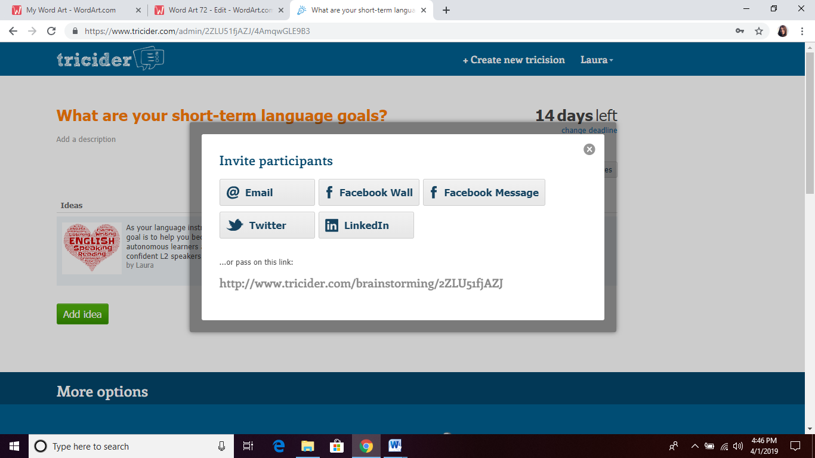
www.tricider.com
HOW IT WORKS
3. Invite Participants and Share

Slide 8
www.tricider.com
HOW IT WORKS
4. Answer the Question, Respond to Students, Vote Favorite Idea

Slide 9
www.tricider.com
HOW IT WORKS
5. Review and Collect Results

Slide 10
www.tricider.com
HOW IT WORKS
5. Review and Collect Results

Slide 11
www.tricider.com
WHY IT IS GREAT
•brainstorm and share ideas
•hone writing skills
•develop critical thinking skills
•become more autonomous L2 learners
•communicate more in and out of classroom

Slide 12
www.tricider.com
DEMO QUESTION
Who makes better ESL teachers: Native or non-native English speakers?

Slide 13
www.tricider.com
REWARD
Most voted tricider idea

